Slide 1
PARKKAR
BANNARI AMMAN INSTITUTE OF TECHNOLOGY
KOKILA M – II YEAR CSBS
ANJANA A R K – II YEAR CSBS

Slide 2
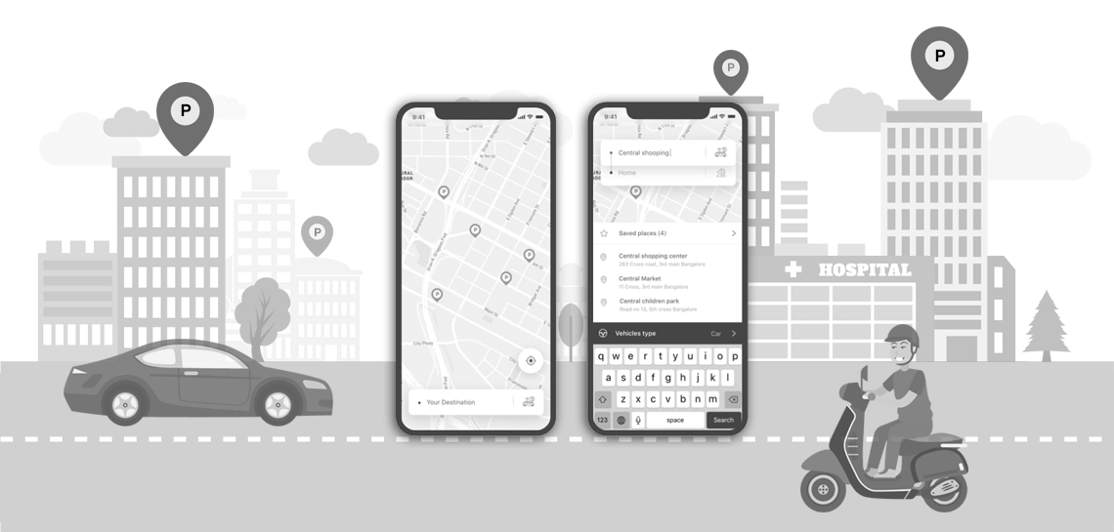
TAGLINE: “PARK EASY AND PARK SAFE!”

Slide 3
PROBLEMS SOLVED:
3.51 million cars are there in this country
Massive problem in finding parking spaces
Traffic in major markets and public hotspots
End up in police station, get damaged by the traffic or is stolen
Instant requirement for a sophisticated parking lot location system which can show the nearby parking lots
Bridge between the parking lot administrators and the common people
Shows nearest parking lot and shortest distance to the lot
Helps find safe parking lots and makes trip easier
Income for parking lots admins by increasing customer

Slide 4
CHALLENGES FACED:
Which APIs to use for implementation?
Google Map API as it was our first attempt using it
Jsonweb-token Authentication kept failing and prevented users from signing in
Mix-up between the authentication for both Parking lot and User Authentication
VSCode Bug which could be removed by clearing out the npm-cache

Slide 5
TECHNOLOGIES USED:
MongoDB
Nodejs
Expressjs
Flutter (Dart)

Slide 6
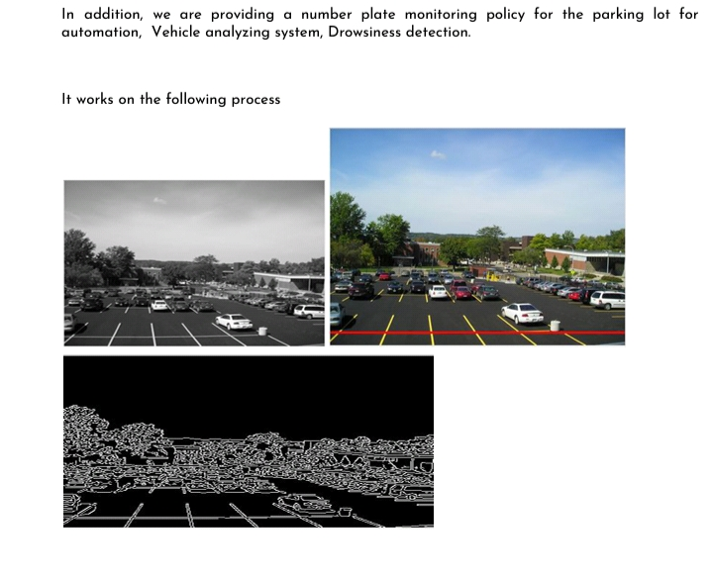

Slide 7
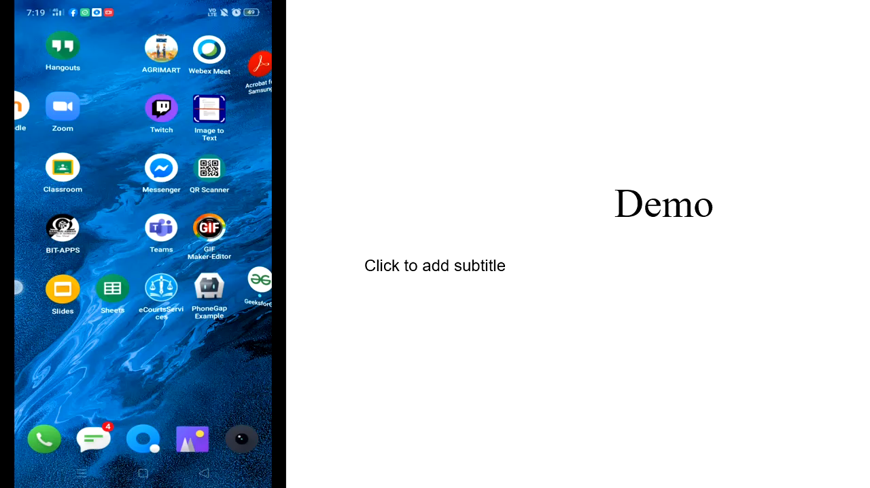
Project Name :: Parkara
Bannari Amman Institute Of Technology
Kokila M – 2nd Year Csbs
Anjana A R K – 2nd Year Csbs

Slide 8
THANK YOU!

